Slide 1
Multiresolution Knowledge Distillation for Anomaly Detection
Paper Presentation On
Course – Deep Learning with Medical Informatics (CS 895)
By – Monalika Padma Reddy

Slide 2
INTRODUCTION
Anomaly detection (AD)
Aim - To identify test-time inputs that appear abnormal in comparison to the normal samples in training data.
Require the pixel-precise localization of the anomalous regions, called defects.
Traditionally, the AD problem has been approached in a one-class setting
Anomalies represent a broadly different class from the normal samples.
Due to the unsupervised nature of the AD problem, restricted data access, availability of just the normal data in training, most methods model the normal data abstraction by extracting semantically meaningful latent features.
Disadvantages –
Results in generality problem by declining trust in the methods on unseen future datasets.
Anomaly localization is either impossible or poor in most of them
Leads to intensive computations that hurt their real-time performance.
Models suffer from unstable training, requiring unprincipled early stopping to achieve acceptable results

Slide 3
APPROACH OF THE PAPER
Proposed a novel knowledge distillation method
Designed to distill the comprehensive knowledge of an ImageNet pre-trained source network, solely on the normal training data, into a simpler cloner network
Done by forcing the cloner’s intermediate embedding of normal training data at several critical layers to be similar to the source embeddings.
Cloner learns the manifold of the normal data thoroughly, and yet earns no knowledge from the source about other possible input data.
Hence, the cloner will behave differently from the source when fed with anomalous data.
Simpler cloner architecture enables avoiding distraction by non-distinguishing features, and enhances the discrepancy in behavior of the two networks on anomalies
Derive precise anomaly localization heat maps, without using region-based expensive training and testing, through exploiting the concept of gradient.
Evaluated the method on a comprehensive set of datasets on various tasks of anomaly detection/localization where the proposed model exceed the SOTA in both localization and detection

Slide 4
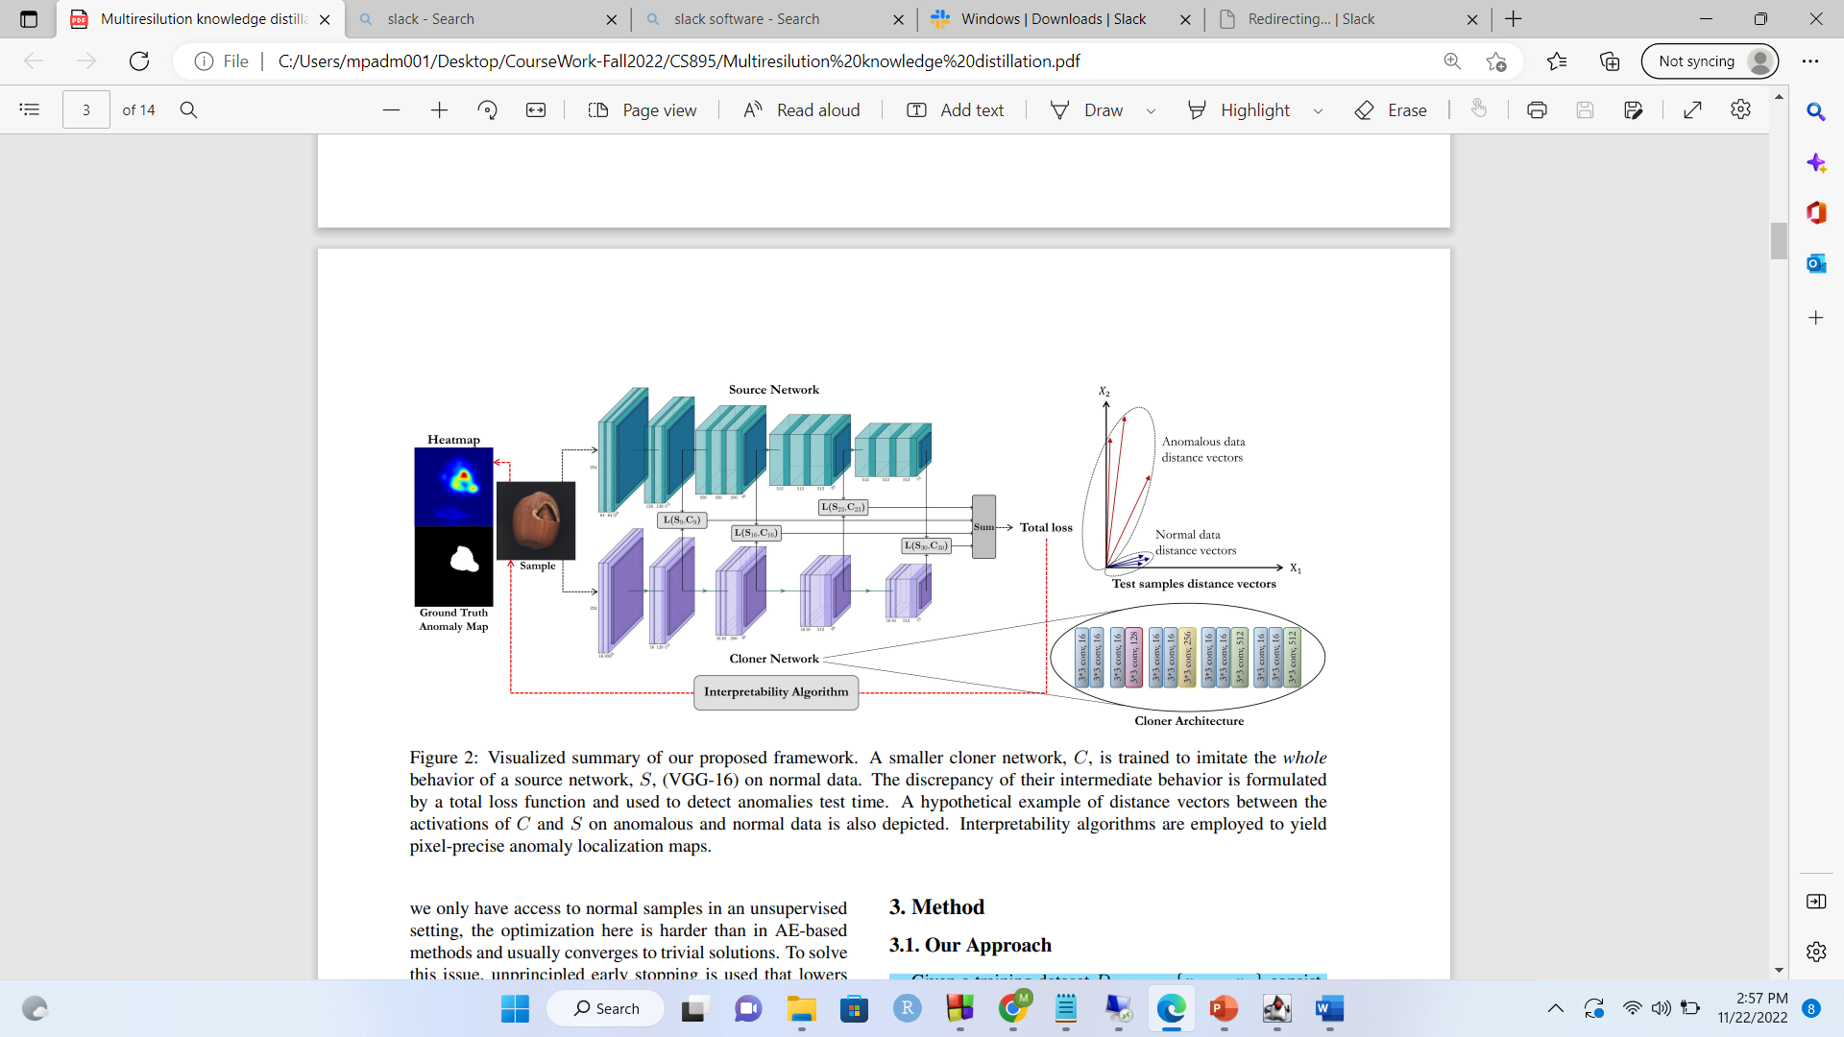
Training Dataset Dtrain = {x1,… xn} consists only of normal images (No anomalies)
Cloner network C is trained, which detects the anomalies in the test set Dtest and localizes the anomalies in those images with the help of a pre-trained network
Cloner network needs to predict the deviation of each sample from the manifold of normal data => it needs to know the manifold quite well.
Therefore, it is trained to mimic the comprehensive behavior of an expert network, called the source network S.
Earlier works in knowledge distillation – teach the output of the source to the cloner network.
Disadvantages –
Shares a little portion of S’s knowledge with C.
Results in the optimization to stuck in irrelevant local minima
Here, the intermediate knowledge of S on the normal training data is transferred to C
Cloner network C is provided with multiple intermediate hints from Source network
Done to encourage C to learn S’s knowledge on normal samples through conforming its intermediate representations in several critical layers to S’s representations.
Mimicking different layers, educates C in various abstraction levels which leads to a more thorough final understanding of normal data

Slide 5
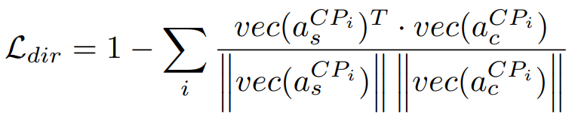
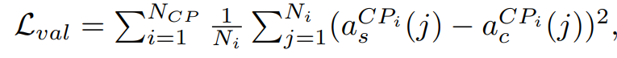
Notion of knowledge can be seen as the value of activation functions
Define the notion of knowledge as both the value and direction of all activations to intensify the full knowledge transfer from S to C.
2 losses – Lval and Ldir is defined
Lval – Aims to minimize the Euclidean distance between C’s and S’s activation values
Ldir - to increase the directional similarity between the activation vectors, using the cosine similarity
More vital in ReLU networks whose neurons are activated only after exceeding a zero-value threshold.
Indicates that two activation vectors with the same Euclidean distance from the target vector, may have contrasting behaviors in activating a following neuron
To address this Ldir is defined using the cosine similarity metric
This encourages the activation vector of C be not only close to the S’s one in terms of Euclidean distance but also be in the same direction
Ltotal = Lval + λ Ldir
λ is set to make the scale of both constituent terms the same
Training using Ltotal, continues to fully converge, which is the only accessible criterion to measure when to stop training epochs.
The architecture of C is designed to be simpler than S to enable knowledge “distillation”. Compression of the network facilitates the concentration on normal main features.
While the source needs to be a very deep wide model to learn all necessary features to perform well on a large-scale domain dataset, like ImageNet, the goal of the cloner is simply acquiring the source’s knowledge of the normal data.
Total number of critical layers
Number of neurons
Cloner Activation Values
Vec (x) - vectorization function transforming a matrix x with arbitrary dimensions into a 1-D vector
Encourages the activation vector of C be not only close to the S’s one in terms of Euclidean distance but also be in the same direction
Source Activation Values

Slide 6
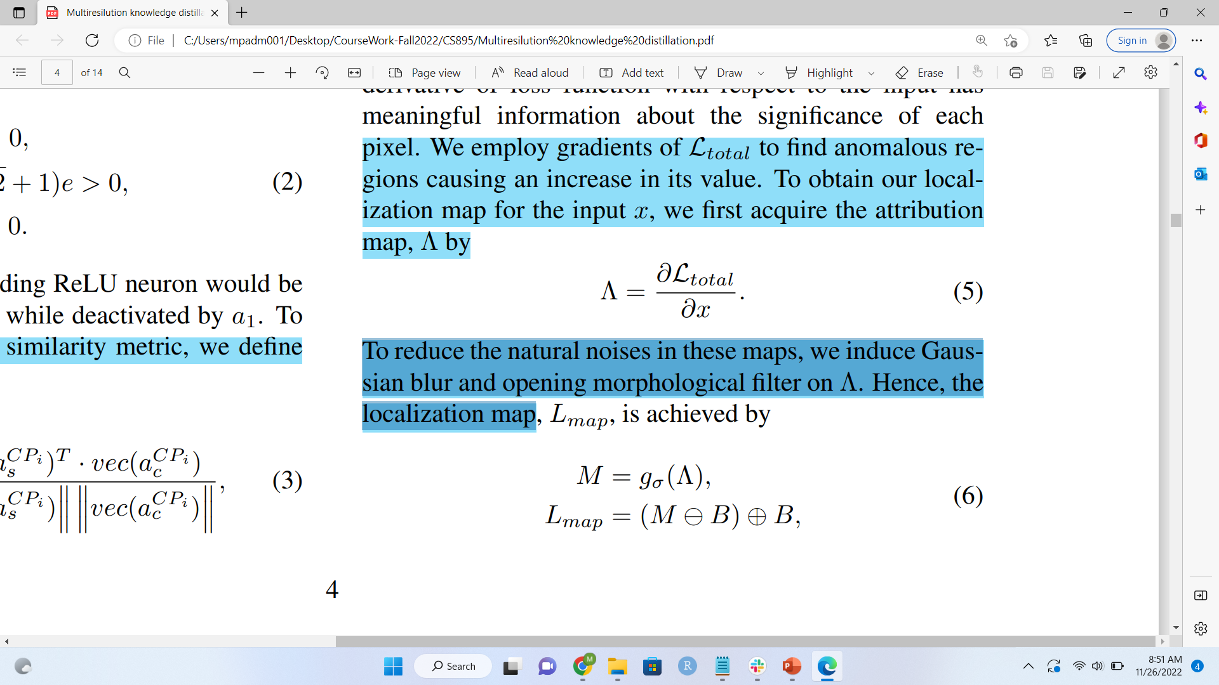
Anomaly Detection:
To detect anomalous samples, each test input is fed to both S and C.
Since S has only taught the normal point of view to C – anomalies (inputs out of the normal manifold) are a potential surprise for C.
S is knowledgeable on anomalous inputs.
Leads to a potential discrepancy in their behavior with anomalous inputs that is thresholded for anomaly detection
Ltotal = Lval + λ Ldir formulates this discrepancy.
Anomaly Localization:
Gradients of Ltotal is employed to find anomalous regions causing an increase in its value
To obtain localization map for the input x, the attribution map is calculated
To reduce the natural noises in these maps, Gaussian blur and opening morphological filter is introduced on Λ.
Together, called opening, these operations remove small sporadic noises and yield clean maps
Gaussian filter with standard deviation
Morphological erosion and dilation by a structuring element B. B - a simple binary map

Slide 7
RESULTS
Datasets –
MNIST
Fashion MNIST
CIFAR 10
MVTecAD
Retinal OCT Images (optical coherence tomography)
HeadCT
BrainMRI for brain tumor detection
Evaluation Protocol –
Medical datasets: 10 random normal images + all anomalous ones for test, the rest normal ones for training.
MVTecAD & Retinal-OCT: datasets train and test sets are used.
Others: one class as normal and others as anomaly, at testing: the whole test set is used
Medical Datasets

Slide 8
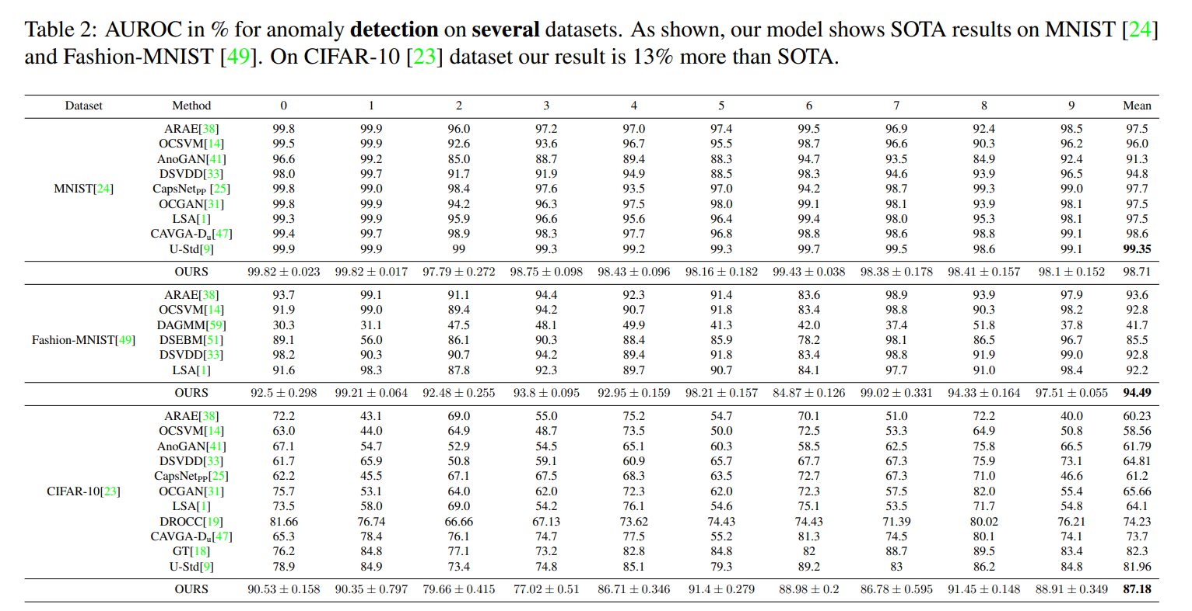

Slide 9
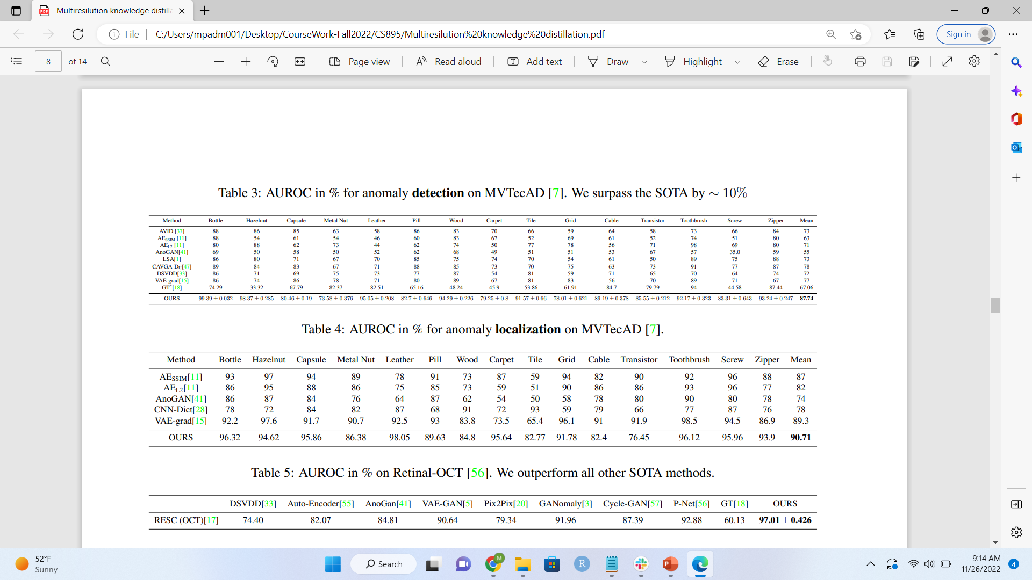

Slide 10
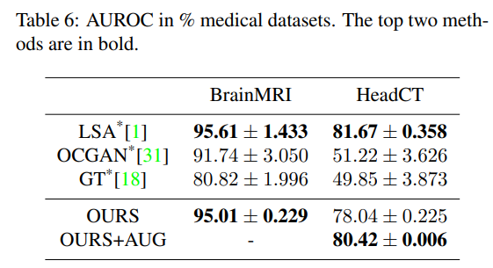
Training data is dramatically limited, method can possibly face difficulties transferring the S’s knowledge to C. However, this can be addressed by using simple data augmentations. 20 degree rotation used in addition to scaling in range [0.9, 1.05] to augment the images. These augmentations are generic non-tuned ones aiming solely to increase the amount of data with no dependency to the dataset

